Slide 1

EMPLOYEE ATTRITION ANALYSIS
\

Slide 2

OVERVIEW
This presentation provides a comprehensive understanding of employee attrition, highlighting the various factors that contribute to the loss of employees over time, aiming to maintain stability and productivity.
The reduction in number of employees through retirement, voluntary/involuntary resignation or death is called Attrition.

Slide 3

Why do Employees Leave?
Inability to manage Work Pressure
Uncooperative Team Members
Lack of Appreciation
Long Work Hours
Health / Age problems
Lack of Growth Opportunities

Slide 4

Effects of Attrition
Low Productivity
Loss of Knowledge
Increased Pressure on Management
Decreased Morale
Potential damage to Employer Brand
Decreased Employee Engagement
Increased Training Costs
Loss of Client Relationship
Disruption of Projects
Negative impact on other team members

Slide 5
PROBLEM STATEMENT
XYZ company was established a few years back is facing around 15% attrition rate for a couple of years and it is majorly affecting the company in many aspects. In order to understand why employees are leaving the company and reduce the attrition rate XYZ company has approached a HR analytics consultancy for analyzing the data they have.

Slide 6
Details Of Data
DAX (Data Analysis Expressions) is employed to create calculated columns and measures that provide deeper insights into attrition rates and patterns. Visualization tools within Power BI, such as charts, graphs, and maps, are then utilized to present the data in an interactive format. These visuals can highlight key metrics like turnover rates by department, tenure, reasons for leaving, and demographic factors. The outcome is a comprehensive HR dashboard that empowers stakeholders with actionable insights, enabling them to identify trends, predict future attrition, and develop strategies to improve employee retention.

Slide 7
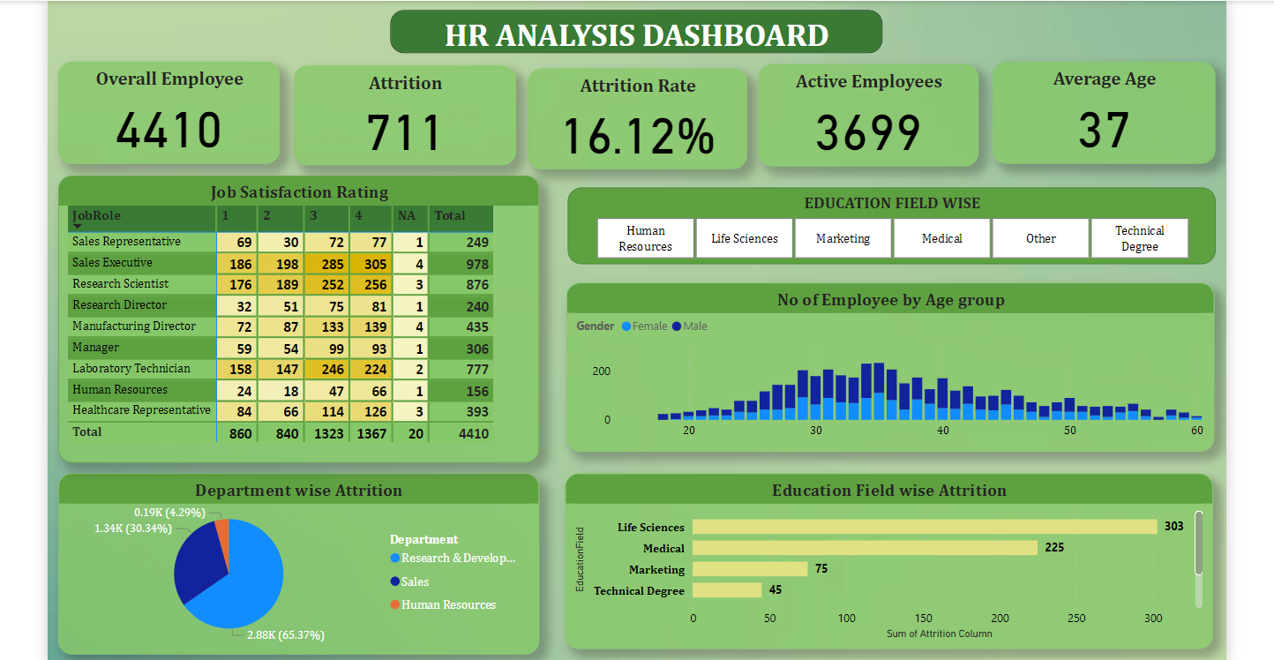

Slide 8




Understanding the Analysis
Key metrics include overall attrition rate, voluntary vs. involuntary attrition, attrition by department, role, tenure, and demographics.
Key metrics include overall attrition rate, voluntary vs involuntary attrition, attrition by department role, tenure and demographics
Adapting to changing workforce dynamics, such as remote work, evolving employee expectations is essential for effective reducing attrition
Analyzing attrition at different stages of the employee lifecycle can pinpoint critical periods for retention efforts
Comparing attrition rates with industry standards helps identify areas of strength and opportunity
Addressing Job Satisfaction factors reduces turnover rate

Slide 9
Support and Development
Role Clarity
Clarifying roles, responsibilities and expectations to align employee efforts with organizational goals
Trust and Respect
Investigating factors that contribute to building trust and mutual respect between employees and managers
Decision Making Processes
Analyzing how decisions are made and communicated within organization and their impact on employee morale
Leadership and Communication
Comparing different managerial approaches and their influence on employee satisfaction and communication patterns which impact trust and clarity

Slide 10

CONCLUSION AND NEXT STEPS

Slide 11

This analysis is provided to empower organizations to make informed decisions based on data-driven insights into workforce dynamics and trends. As organizations navigate evolving workforce challenges, HR Dashboards serve as essential tools for adapting strategies and staying competitive. Next steps involve refining dashboard metrics to align more closely with objectives and expanding data sources for deeper insights.

